Slide 1
Artificial fertilisation and fertility drugs
IGCSE Biology

Slide 2
Fertility drugs
Sometimes a couple want to have children but cannot because the man or woman is infertile.
One cause of infertility in women is the ovaries do not release eggs.
This may be due to a lack of FSH production by the pituitary gland.

Slide 3
Fertility drugs
Treatment for this type of infertility may involve regular injections of a fertility drug that contains FSH.
The FSH stimulates the ovaries to release eggs.
This increases the chances of pregnancy.

Slide 4
Fertility drugs
Other treatments involve tablets that make the pituitary gland insensitive to oestrogen.
Oestrogen inhibits the production of FSH, so if the effect of oestrogen on the pituitary gland is blocked by the drug, then it continues to release FSH and ovulation takes place.
Trick question: When should the drug be taken or injected?

Slide 5
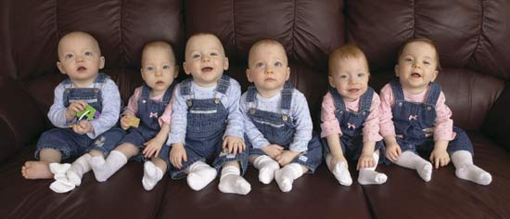
Problems
Fertility treatment does not always work in some couples.
However, sometimes it can work too well and too many eggs can be released – resulting in several babies being born.
Welcome to the Headrick sextuplets.

Slide 6
AI
Some couples cannot have children because the man is infertile.
This may be because he does not produce enough sperm or there are problems with ejaculation.
It is possible that semen can be collected from the man and placed into the woman’s uterus.
This process is called artificial insemination(AI).

Slide 7
If the man does not produce enough sperm for this, or the sperm cells are not suitable, then a donor may produce a sample of semen for artificial insemination.
AI by donor may lead to problems later in life because the child’s father is not the biological father.

Slide 8
IVF
It is also possible to take the nucleus from a defective sperm cell and inject it into an egg cell.
The zygote is then cultured for a few days in a solution of food and oxygen.
This allows it to grow into an embryo, which is then transferred into the woman in the hope that it implants in the uterus.
This is called in vitro fertilisation (IVF).

Slide 9
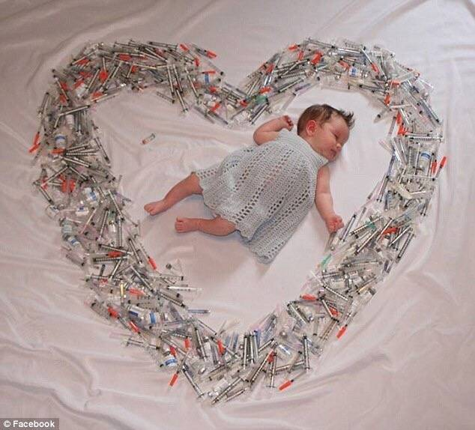

Slide 10
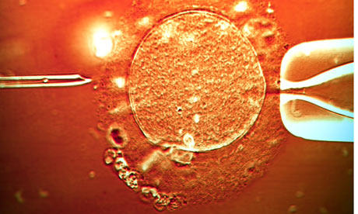
IVF

